Slide 1
Real Time Face Recognition System for Classroom Attendance
GUILLERMO GARCIA DE CELIS KEVIN TRUONG

Slide 2
AGENDA
01
INTRODUCTION
04
THEORETICAL FRAMEWORK
What is facial recognition?
Why use it for class attendance?
Goal = real-time system that identifies students automatically.
What are embeddings? (128-dim vectors)
Cosine Similarity explained (+ simple formula)
Why FaceNet was crucial: turns few-shot problems into similarity search.
05
METHODOLOGY
02
MOTIVATION
Phase 1: CNN Classification (Initial Attempt)
Phase 2: Embedding-Based Recognition (Final Solution)
Problems with traditional attendance: Time-consuming, manual errors.
How facial recognition offers speed, automation, and accuracy.
06
DISCUSSION
03
KEY CHALLENGES
Strengths: Speed, Automation, Good generalization even with few images.
Weaknesses: Lighting conditions, limited samples, false positives/negatives sometimes.
Data Scarcity: Only 1-2 images per student.
Overfitting: Small dataset → hard to generalize.
Pre-trained Models Importance: (transfer learning)
Similarity vs Classification: (using embeddings instead of predicting class labels directly)
07
REFERENCES

Slide 3
01
INTRODUCTION

Slide 4
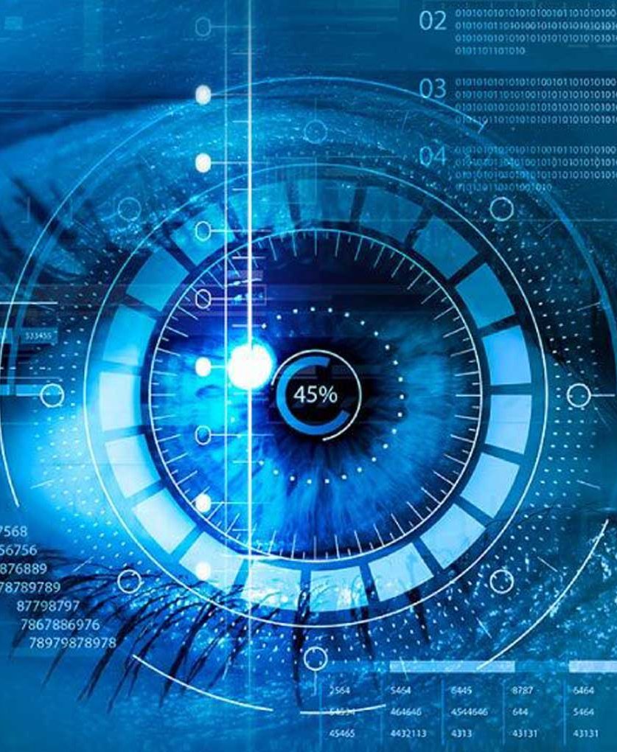
Facial recognition is a biometric technology that identifies or verifies individuals based on facial features extracted from images or videos.
It involves detecting a face, analyzing key landmarks, and matching it against a database.
WHAT IS FACIAL RECOGNITION?

Slide 5
WHY & GOAL
Why use it for class attendance? Traditional roll calls are time-consuming, manual, and error-prone. Facial recognition can automate this process, making it faster, more accurate, and less disruptive to class flow.
Our Goal: To create a real-time system capable of identifying students using a live camera feed, minimizing the need for manual intervention.

Slide 6
02
MOTIVATION

Slide 7

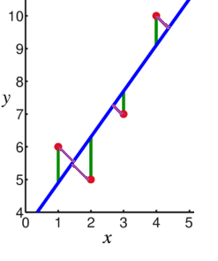

01
02
03
TRADITIONAL ATTENDANCE PROBLEMS
Manual processes slow down class activities.
Higher chance of human error or proxy attendance (students signing in for friends).
Tedious record-keeping.

Slide 8
Benefits of Facial Recognition
Quick, automatic attendance taking.
Reduces errors.
Prevents fraudulent attendance.
Provides real-time analytics.
Wider Impact: Technology learned here can be adapted beyond classrooms: offices, conferences, or public events.

Slide 9
03
KEY CHALLENGES

Slide 10
CHALLENGES FACED
Data Scarcity:
Only 1–2 images available per student.
Deep learning typically requires hundreds or thousands per class.
Overfitting:
Models trained on such small datasets memorized images but failed to generalize to new images.
Initial CNN classifier showed very high training accuracy but poor testing accuracy.
Importance of Pre-trained Models:
Using models like FaceNet and VGGFace trained on millions of faces helped us transfer learned features.
Transfer learning allowed us to adapt to our small dataset.
Similarity vs. Classification:
Instead of forcing the system to classify among students (which needs many samples), we compared faces using similarity scores.
Embedding-based recognition was the breakthrough that allowed good performance even with few images.

Slide 11
04
THEORETICAL FRAMEWORK

Slide 12
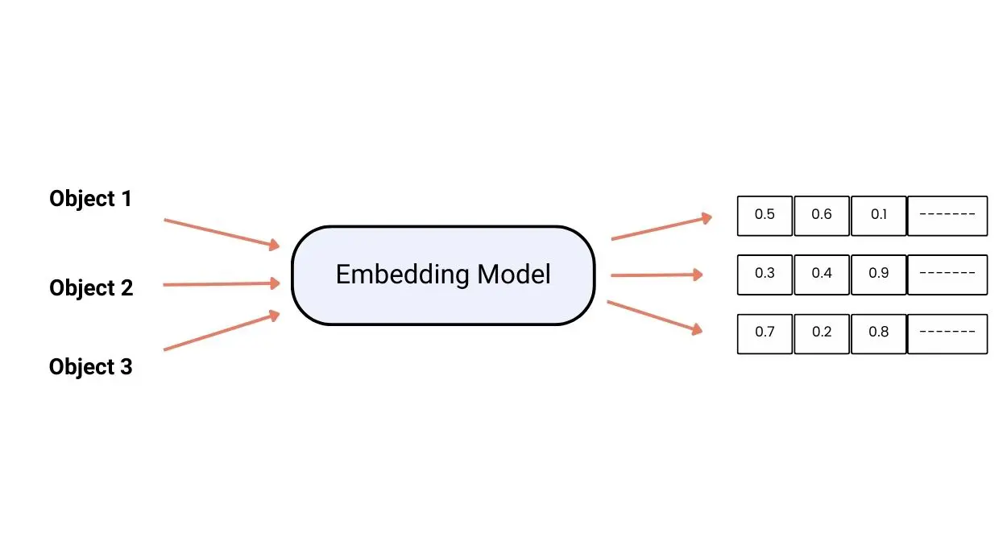
What are embeddings?
Embeddings are numerical representations of objects
Embeddings are 128-dimensional vectors representing faces.
These vectors encode important facial features (like the distances between eyes, jaw shape, etc.) in a way machines can easily compare.

Slide 13
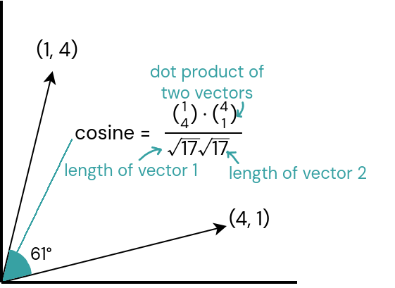
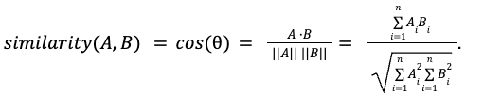
Cosine Similarity
Measures how similar two vectors are.
Formula:
If similarity is close to 1.0, it means faces are nearly identical.
Lower similarity means faces are different.

Slide 14
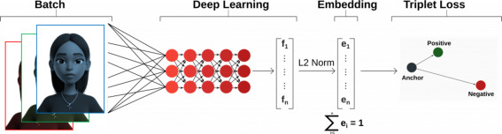
FaceNet’s Role
FaceNet doesn't classify faces directly.
It learns a space where faces from the same person are closer together.
Ideal for few-shot learning problems like our where faces from the same person are closer together.
Ideal for few-shot learning problems like our

Slide 15
05
METHODOLOGY

Slide 16
PHASE 1: CNN Classification (Initial Attempt)
Idea: Build a CNN that directly predicts student identity.
Data:
Classmates' Canva profile photos.
Public Labeled Faces in the Wild (LFW) dataset for more variety.
Model:
Fine-tuned VGG16 and MobileNet models.
Data Augmentation:
Random flips, rotations, zooms, color adjustments to artificially expand dataset.
Result:
Severe overfitting.
Low real-world performance on new camera inputs.

Slide 17
PHASE 2: Embedding-Based Recognition (Final Solution)
Strategy:
Use FaceNet to extract 128-dim embeddings for every student photo.
Store embeddings in a database.
During real-time recognition:
Capture a face from the webcam using MTCNN (face cropper).
Extract embedding.
Find the most similar embedding in the database using cosine similarity.
Identify the student based on similarity threshold.
Pipeline:
Face Detection → Detect face in video frame.
Embedding Extraction → Get 128-dim vector.
Similarity Comparison → Compare against database.
Attendance Marking → If a match is found, mark student as present.

Slide 18
06
DISCUSSION

Slide 19
STRENGTHS
Speed:
Attendance is marked in seconds.
Automation:
No human intervention required once setup.
Good Generalization:
Worked even with just one photo per student.
Scalable:
Adaptable for a high group of people.
Adding new students is simple: add their embedding.

Slide 20
WEAKNESSES
Lighting Conditions:
Changes in classroom lighting affected recognition.
Limited Samples:
Faces from unusual angles (profile, tilted) sometimes not recognized.
False Positives/Negatives:
Some faces close in embedding space could be misidentified.

Slide 21
07
REFERENCES

Slide 22
Schroff, F., Kalenichenko, D., & Philbin, J. (2015, June 17). FaceNet: A unified embedding for face recognition and clustering. arXiv.org. https://arxiv.org/abs/1503.03832
VGGFACE2: A dataset for recognising faces across pose and age | IEEE conference publication | IEEE Xplore. (n.d.). https://ieeexplore.ieee.org/abstract/document/8373813
Deng, J., Guo, J., Yang, J., Xue, N., Kotsia, I., & Zafeiriou, S. (2022, September 4). Arcface: Additive angular margin loss for deep face recognition. arXiv.org. https://doi.org/10.48550/arXiv.1801.07698
Labeled Faces in the Wild (LFW) Dataset: Huang, G. B., Ramesh, M., Berg, T., & Learned-Miller, E. (2007). Labeled Faces in the Wild: A Database for Studying Face Recognition in Unconstrained Environments. Official Website: https://www.kaggle.com/datasets/jessicali9530/lfw-dataset
keras-facenet Library: keras-facenet GitHub Repository. Pre-trained Keras implementation of FaceNet. Available at: https://github.com/nyoki-mtl/keras-facenet
Zhang, K., Zhang, Z., Li, Z., & Qiao, Y. (2016, April 11). Joint face detection and alignment using multi-task cascaded convolutional networks. arXiv.org. https://arxiv.org/abs/1604.02878
OpenCV Documentation: OpenCV (Open Source Computer Vision Library). Official Documentation. Available at: https://docs.opencv.org/

Slide 23
THANK YOU
COMPANY NAME

